Slide 1
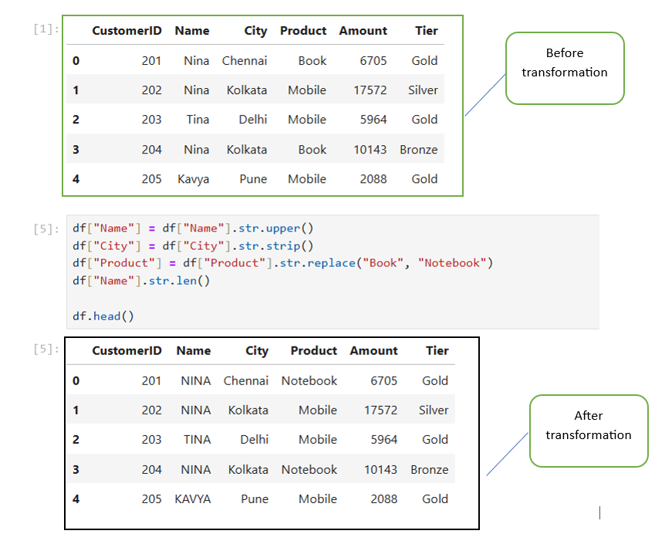
Custom Logic with .apply() and .map()
The Power of Customization: When built-in Pandas functions aren't enough, we write our own.
.map(): Used for element-wise transformations on a Series (e.g., changing 'M' to 'Male').
.apply(): The "Swiss Army Knife." It can run a function across an entire row or column, allowing for complex logic that depends on multiple variables simultaneously.

Slide 2
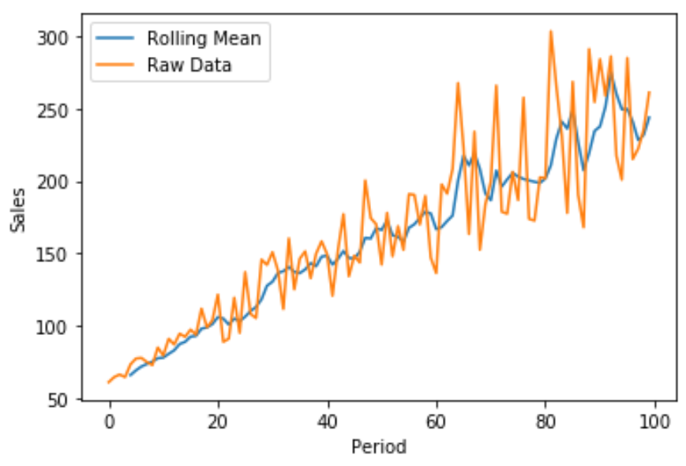
Window Functions (Rolling Statistics)
Analyzing Trends: In real-world data (like stock prices or weather), single data points are often "noisy."
Rolling Windows: Calculating metrics over a moving subset of data (e.g., a 7-day average).
The Goal: Smoothing out short-term fluctuations to see the long-term trend or "signal" in the data.

Slide 3
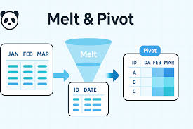
Reshaping Data: Pivoting & Melting
Wide vs. Long Format:
Wide: Easy for humans to read (e.g., a column for every month).
Long: Necessary for computer analysis and visualization (e.g., one 'Date' column and one 'Value' column).
Pivoting: Turning "Long" data into "Wide" (Summarizing).
Melting: Turning "Wide" data into "Long" (Un-pivoting for analysis).

Slide 4

Method Chaining (The Professional Standard)
Code Quality: Avoid creating "Intermediate Variables" (like df1, df2, df3) that clutter your computer's memory.
The Pipeline: Linking operations together in a single, readable block of code.
Readability: Makes the data transformation steps look like a clear recipe that anyone on your team can follow.

